Slide 1
Country-Level 90-90-90 Targets, Progress and Experiences
National HIV/AIDS Program
Dra. Alethse De la Torre Rosas
General Director CENSIDA

Slide 2
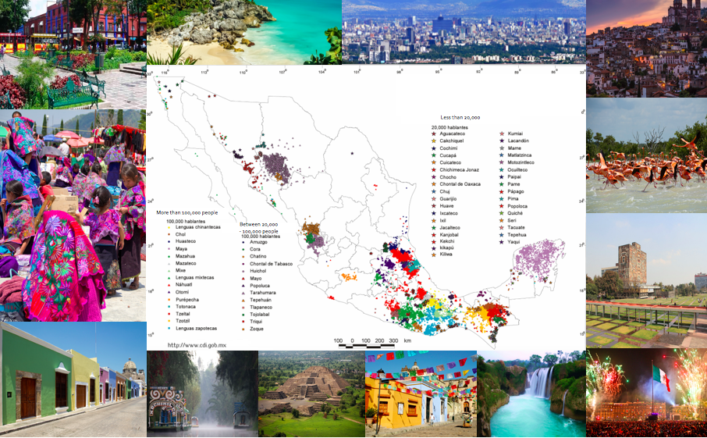
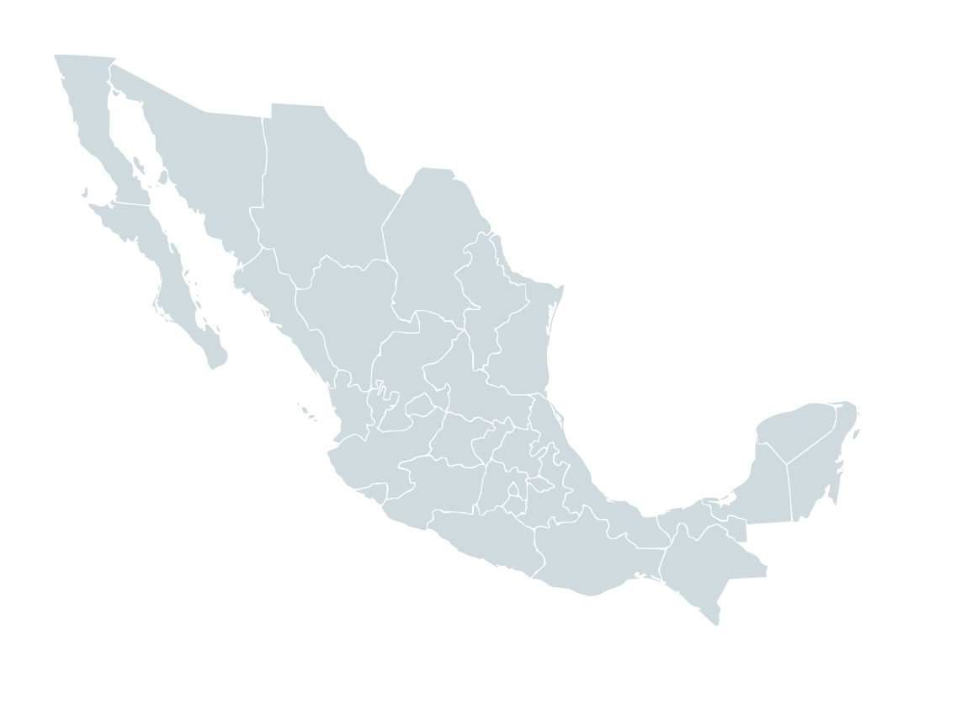
Mexico - overview
Inhabitants
119 million people
10.8% Indigenous population
Republic
32 states
Local government and regulations
Language
Spanish
68 different indigenous languages
http://www.inegi.org.mx

Slide 3
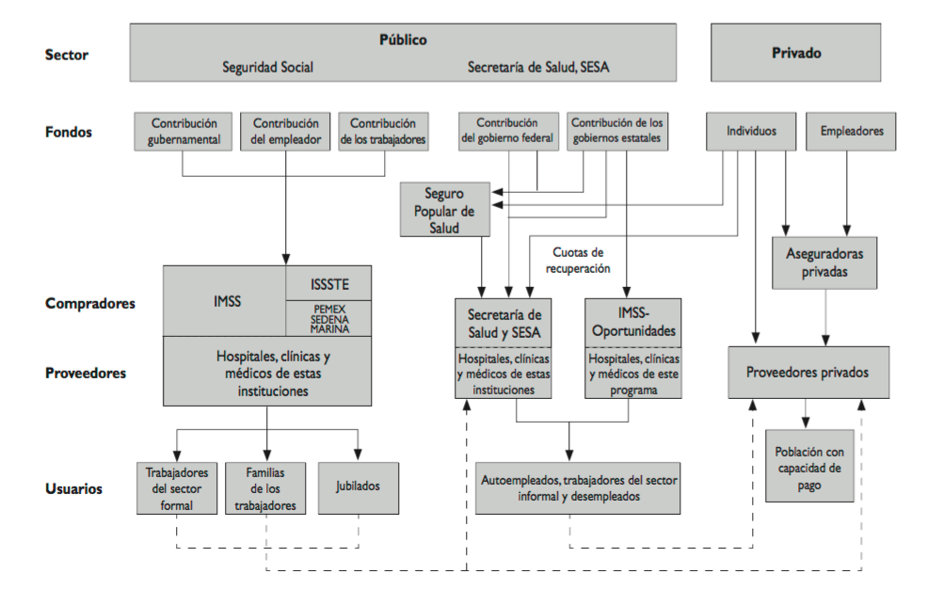
Mexico – Health System snapshot
Sector
Public
Social Security Ministry of Health (Federal/States)
Private
Social Security
Ministry of Health
(Federal/States)
Funds
Government
Employer
Worker
Government
States
Households
Employer
“Seguro popular” insurance
Private insurance
Buyers
IMSS
ISSSTE
PEMEX SEDENA
MARINA
Federal MH
State MH
IMSS
“Bienestar”
Providers
Hospitals, clinics, HCW
Hospitals, clinics, HCW
Hospitals, clinics, HCW
Private Hospitals and clinics
People who can afford private insurance
Users
Workers
Worker’s family
Retiree
Self-employed and unemployed
http://www.scielosp.org/pdf/spm/v53s2/17.pdf
OECD -2016

Slide 4
HIV Continuum of Care estimates: Mexico 2018
<1%
62%
36%
64%
<1%
26%
73%
41%
58%
Private Social Ministry of Health
Security
Private Social Ministry of Health
Security
Social Security Ministry of Health
Advances
Diagnosis
Simplification of diagnosis algorithms.
Publication of HIV Screening Guideline.
Projection of needs for diagnosis test.
Purchase of central government of HIV diagnosis test (MH).
Coordination between CENSIDA and DGE to update epidemiological surveillance manuals (diagnosis algorithms), and update the registry.
HIV Detection Bulletin: monitoring of the detection (MH).
Treatment
Consolidated purchase of ARV medicines.
Needs estimation and centralized purchase of ARV for MH (62% of people in ART).
SALVAR system (operating more than 10 years ago).
Face-to-face and distance training (Edusida).
Viral Suppression
Needs estimation and centralized purchase of monitoring tests (viral load and CD4).
Criteria for application of monitoring tests (saving).
Resistant committee (CORESAR).
Bulletin Attention of people living with HIV and Sector information monitoring.
Source: SS/Censida.

Slide 5
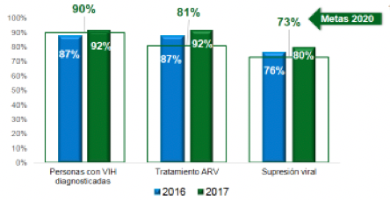
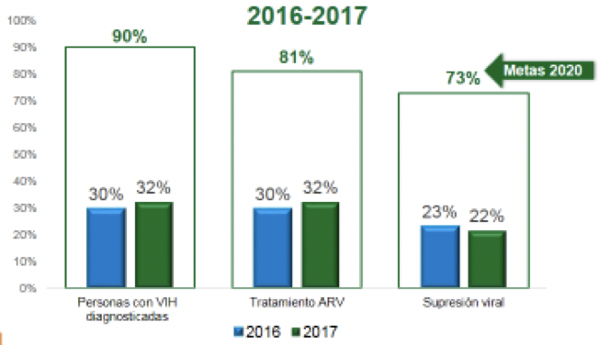
There is regional variation that we need to understand and address
Mexico | 11 000 [7900 - 14 000] | 11 000 [7600 - 14 000]
Source: SS/Censida.

Slide 6
Strengthening treatment options: New paradigm
The need of new treatment options was identified
Access to same ARV treatment options for patients across public health sector
Ministry of Health
Procurement saving proposal
Product Patent
Researchers
Consolidating procurement
Drive down procurement costs, improve terms and decrease product prices
Collaboration
Public Health Sector
Clinical leads
Activists
Altering purchasing patterns
Being able to buy new treatment options
(e.g. Biktarvy®)
Ministry of Finance
Three months

Slide 7
Strengthening treatment options: New paradigm
The need of new treatment options was identified
Achievements so far
The clinical treatment guideline required an official update
Ministry of Health
Procurement saving proposal
A fast track drug registry approval was required (Biktarvy®)
Researchers
Collaboration
Public Health Sector
Clinical leads
31 ARV medicines – Estimated reduction of 55% from the baseline costs
Activists
23 (72%) regions with initial training
Ministry of Finance
ARV Distribution to regions for the next three months
Three months

Slide 8
Challenges faced
PREVENTION, DETECTION, EARLY TREATMENT
Standardization of the ARV Distribution process
Training, dissemination of information, continue engagement with communities, advocates
Person centered registry – to follow up the outcomes that matter to people living with HIV/AIDS

Slide 9
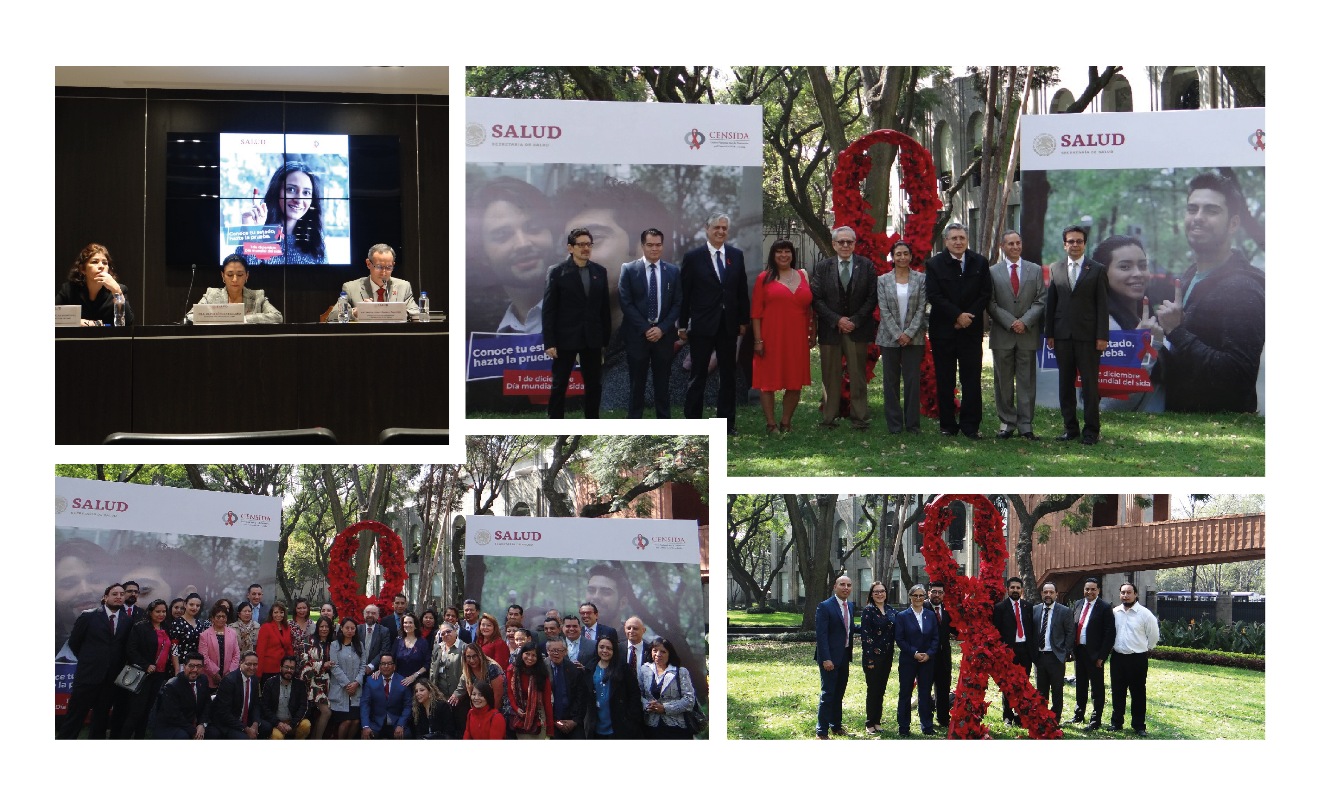
Many thanks! Muchas Gracias!
Alethse.Delatorre@salud.gob.mx

